Slide 1
Interactive TSP

Slide 2
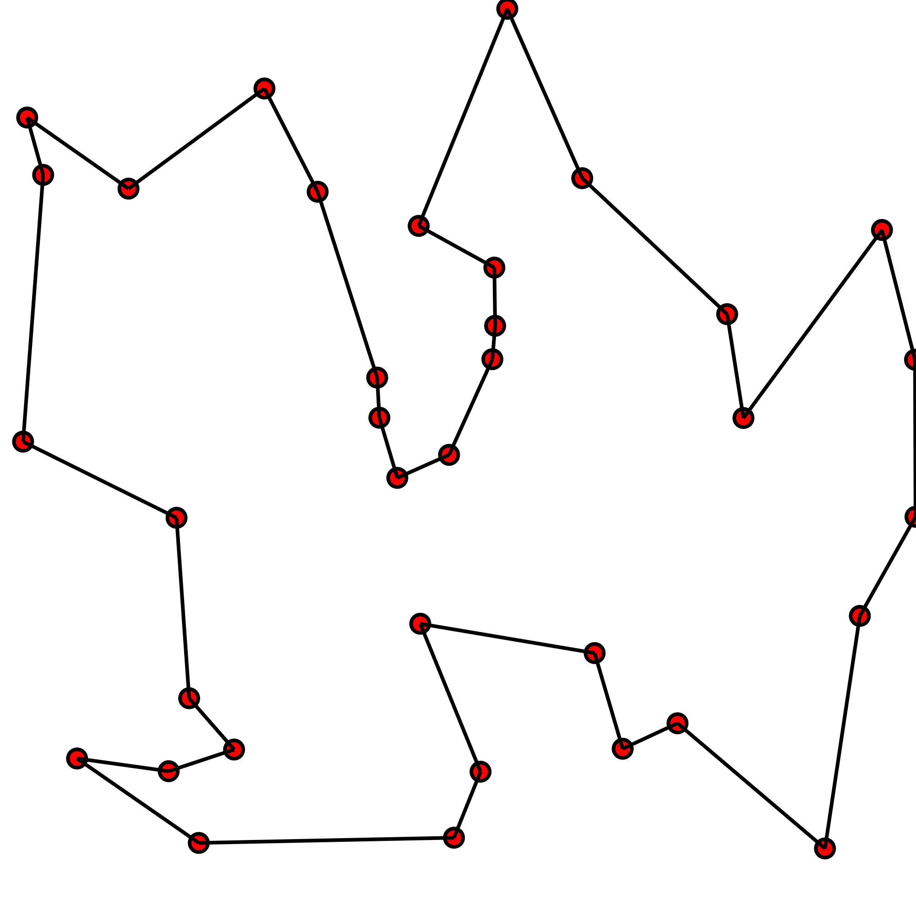

Traveling Salesman Problem
NP-hard problem
N! possible permutations
Euclidian Metric
Minimization of $\sum_{i=0}^{N}{\left|{\vec{x}}_{i}−{\vec{x}}_{i+1}\right|}$

Slide 3
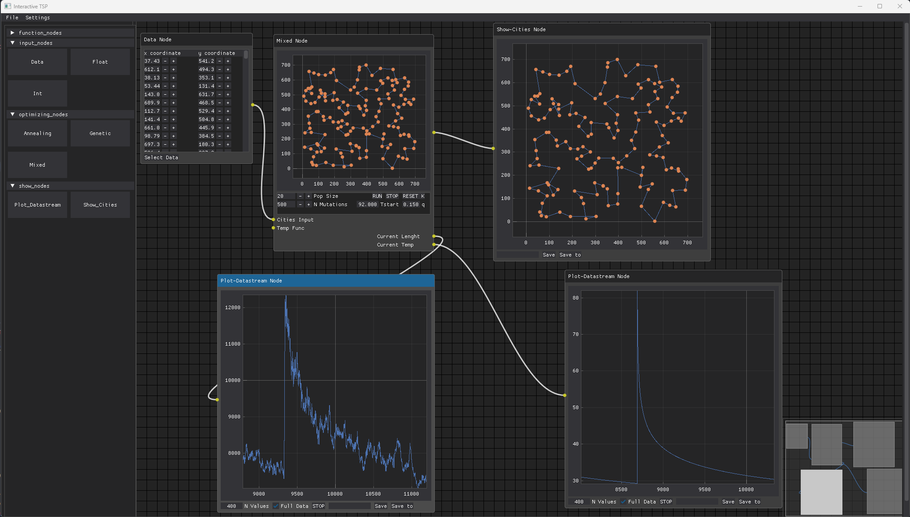

Goals
Dynamic Control
Fast Response
Expandability
Easy to use

Slide 4
Dearpygui Objects
DearPyGui Nodes:
Nodes are UI elements that represent objects or functions.
They can have input and output slots for linking.
Each node is uniquely identified and can be customized.
Objects and Data Flow:
Nodes interact through connections.
Updates propagate dynamically based on changes in linked nodes.
DearPyGui handles rendering, user interactions, and callbacks.

Slide 5
Code Structure
main
Node Classes:
node.add_nodes
Node_editor
Update_nodes
node_instance[node_tag]
node.update
Main Function: Initializes the Node_Editor class and loads node classes dynamically.
Node Editor Class: loads node classes dynamically and displays node editor window
Node Classes: Stored in a nodes folder, each with add_node() and update() functions.
Node Instances Management: Stored in a dictionary using node_tags attribute of Node instance as keys.

Slide 6
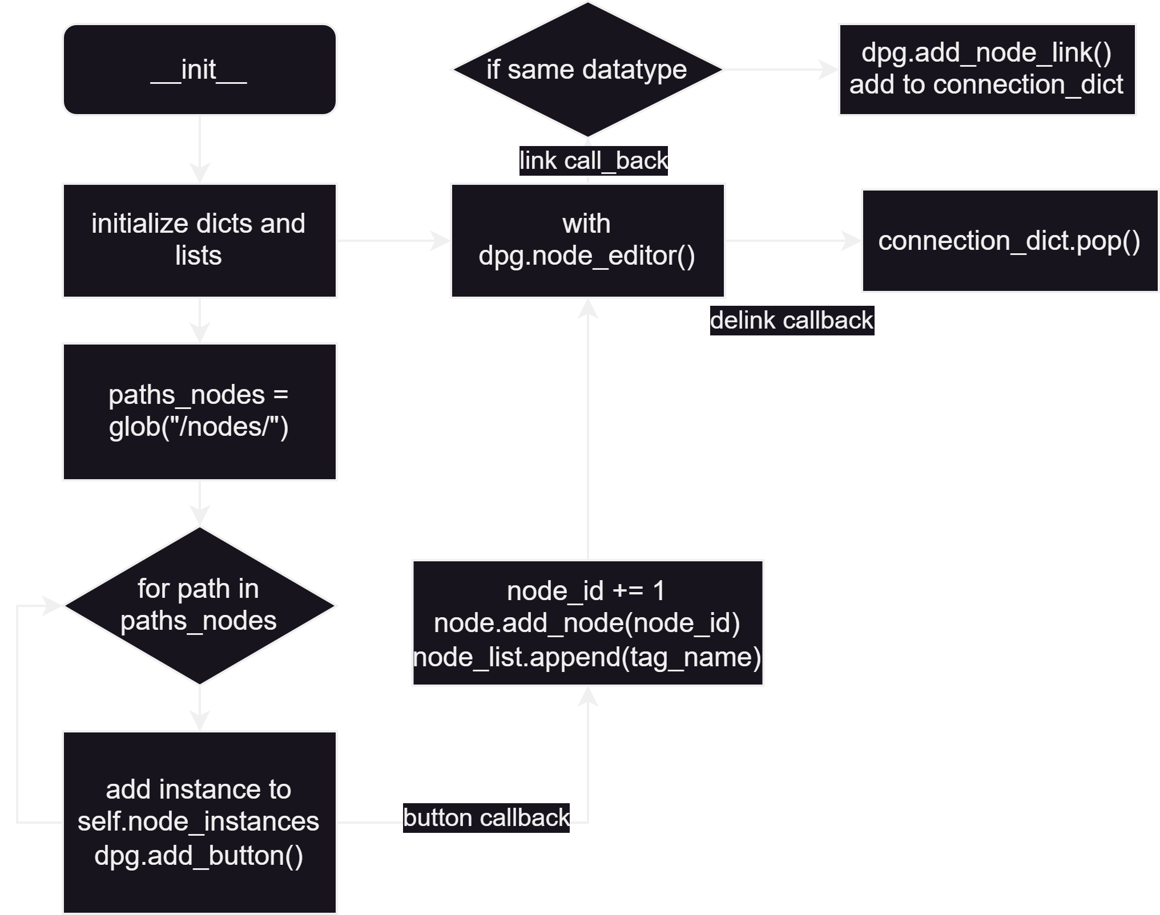
Node Editor
Creating and Managing Nodes:
Node instances are stored in a dictionary.
Buttons in a child window trigger call_back_create_node, which:
Retrieves the instance from the dictionary.
Runs its add_node method to display it in the editor.
Assigns a unique node tag formatted as "ID:node_name" (e.g., "1:Data")

Slide 7
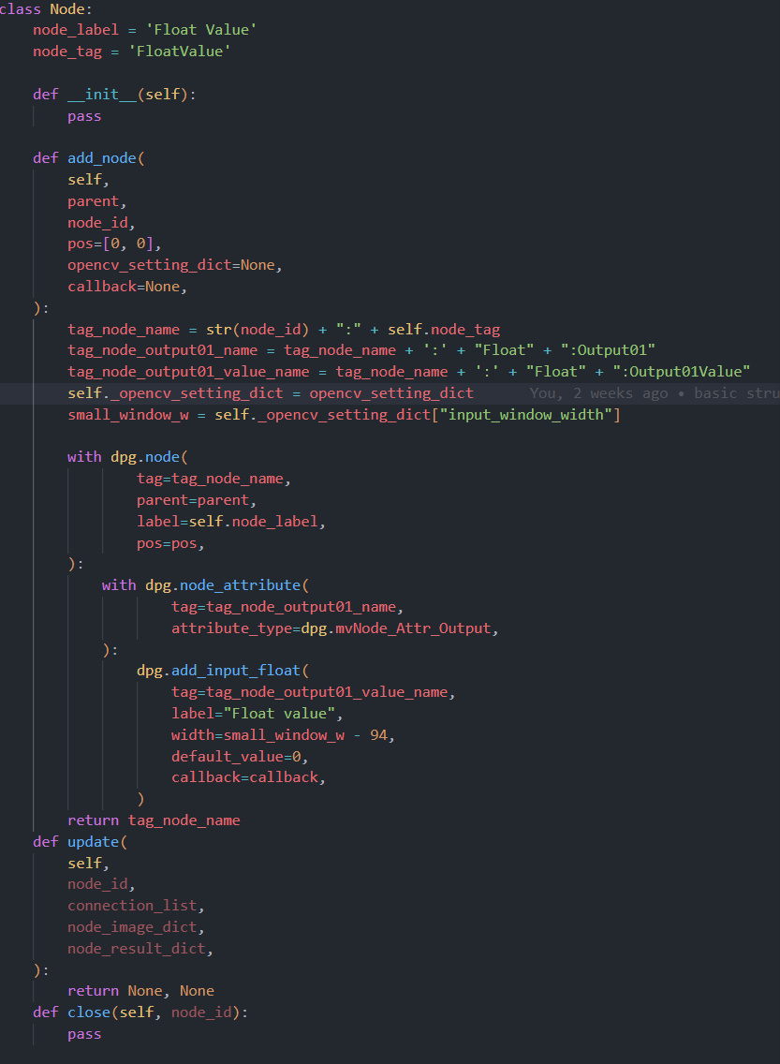
Nodes
Three working types of Nodes
Input Nodes
Optimization Nodes
Display Nodes
All Node classes:
handle the input and output of all dearpygui nodes
initialize dpg.node container with add_node
update the initialized objects or perform calculations

Slide 8
DEMO

Slide 9
